Slide 1

Factorization Machine Techniques for Recommender Systems: A Survey
$$\text{Enneng} \text{Yang}\text{,} \text{Siheng} \text{Li}$$
November 29, 2019

Slide 2

Outline:
Basic Factorization Machine
Improvement of Factorization Machine
Application in Recommendation System

Slide 3
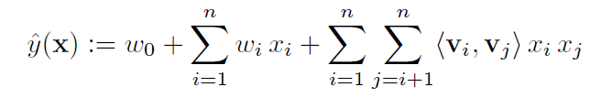
Basic Factorization Machine
[2010-ICDM] Factorization Machines

Slide 4
Outline:
Basic Factorization Machine
Improvement of Factorization Machine
Application in Recommendation System

Slide 5


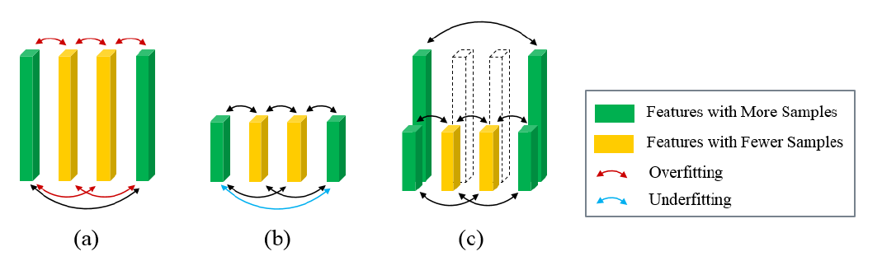

Latent Vector
Overview: Field-aware, Rank-aware, Input-aware, Discrete
Field-aware
Distinguish the difference of interactions between different fields-pairs
(Categorical)
where $f_{i}$ and $fj$ are respectively the fields of $i$ and $j$.
Rank-aware
Most of existing FMs using fixed rank latent vectors, which may lead to overfitting problem for features with few occurrences and underfitting problem for features with large occurrences.

Slide 6





Latent Vector
Overview: Field-aware, Rank-aware, Input-aware, Discrete
Input-aware
The same interactions have different significance in different instances.
Example:
crucial:{young, female, student, pink, skirt}.
less crucial:{young, female, student, blue, notebook}
Discrete
The large number of feature dimension of FM results in expensive storage and computation cost.
changes the real-value latent vector
into binary code

Slide 7
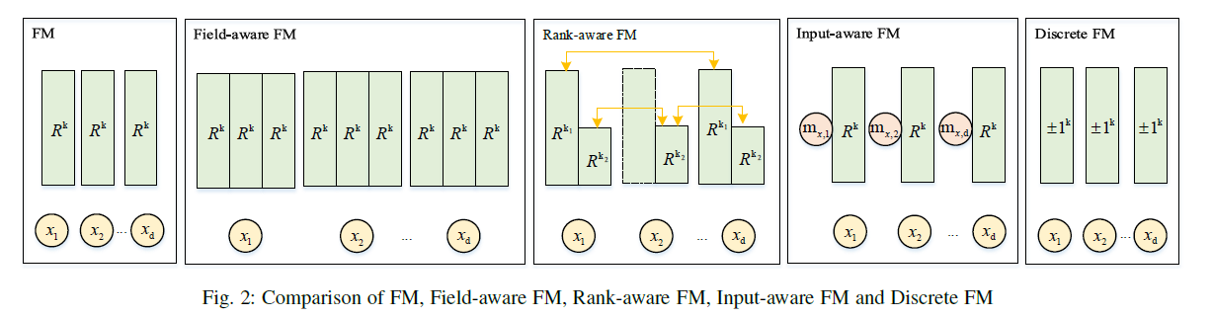
Latent Vector
Overview: Field-aware, Rank-aware, Input-aware, Discrete

Slide 8


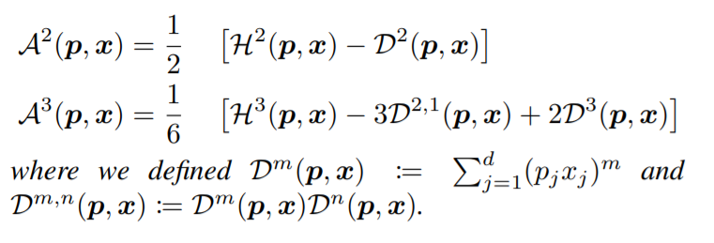

FMs With Kernel
ANOVA Kernel:
High-Order FM:
Linearity of ANOVA Kernel:

Slide 9


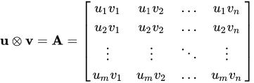
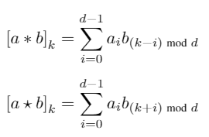

FMs With Other Product Strategy
FM
Inner Product:
Output is scalar
Easy and Fast
Be used in traditional FM
NFM
Hardmard Product:
Output is vector
More information
Be used in FM with DNN
PNN
Outer Product:
Output is matrix
Most information
Be used in PNN, CFM
HFM
Holographic Reduced Representation:
Output is vector
Associative Retrieval
Be used in HFM

Slide 10
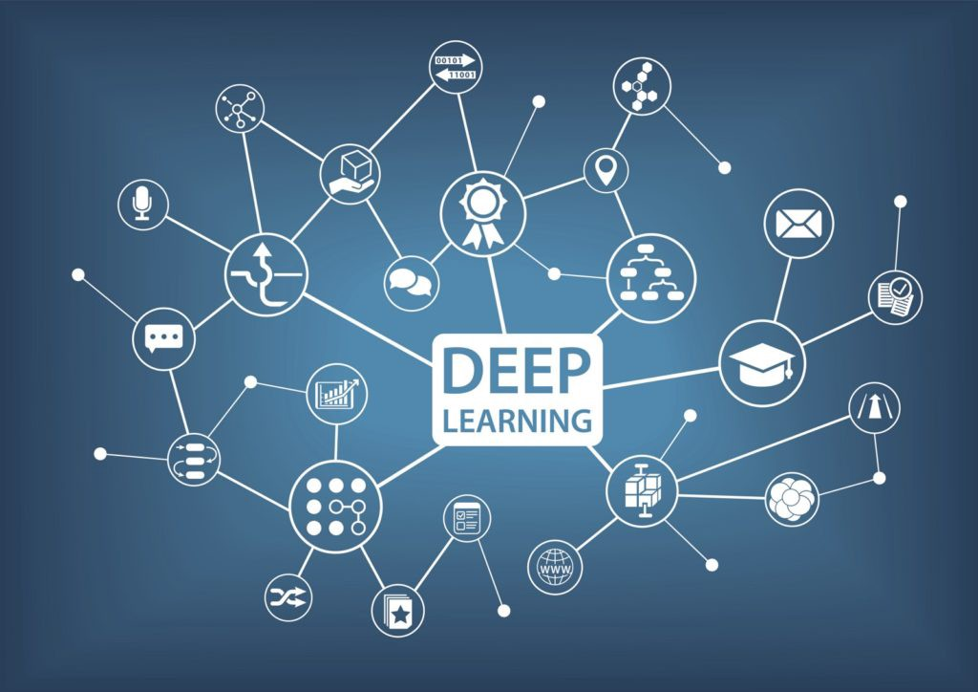
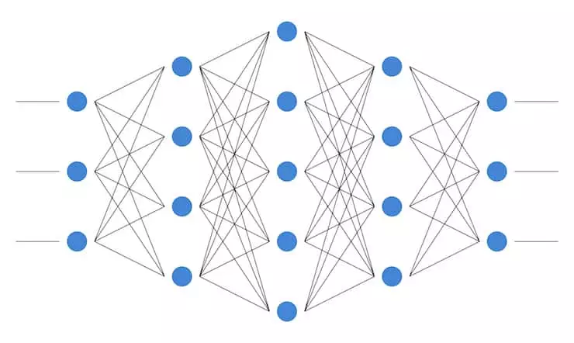
FM with Deep Learning Methods
Deep Learning is an end-to-end learning method which integrates feature combination and special work, it performs well in many fields, e.g. Convolutional Neural Networks (CNN) in Computer Vision, Recurrent Neural Networks (RNN) in sequential problem, etc.
There are many works combing FM and Deep Neural Network (DNN) to explore the inherent structure of real-word data.

Slide 11
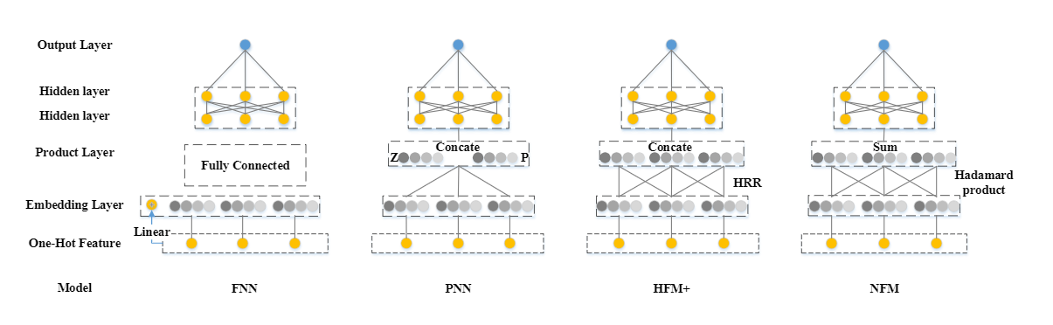
Typical Serial Model

Slide 12
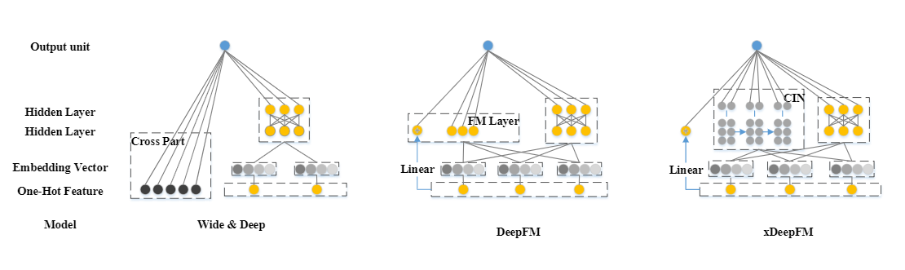
Typical Parrallel Model

Slide 13
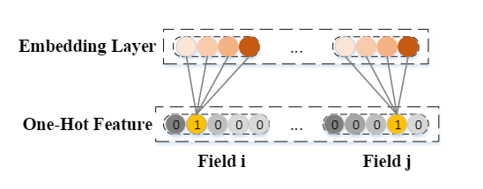
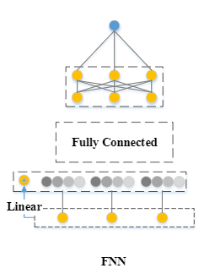
[2016-ECIR] Deep Learning over Multi-field Categorical Data
Characteristics:
1. By leading in Neural Network, FNN captures high-order interactions more easily than Basic FM
2. Compare to the linearity of Basic FM, Neural Network does better when dealing with complex real world data.
4. FNN explores feature interactions by fully connecting MLP means that it uses ”add” operations to model interactions, while it has been shown that ”product” operations can be more efficient

Slide 14
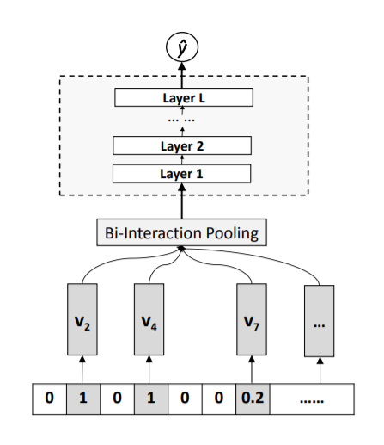
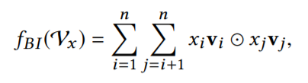
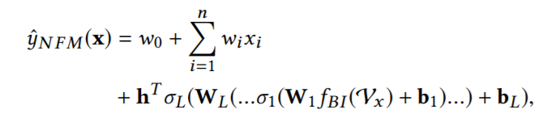
[2017-SIGIR] Neural Factorization Machines for Sparse Predictive Analytics
Characteristics:
Leading in product layer to tackle the problem of FNN

Slide 15
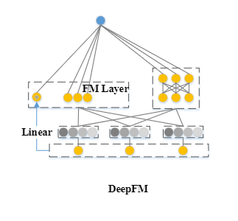

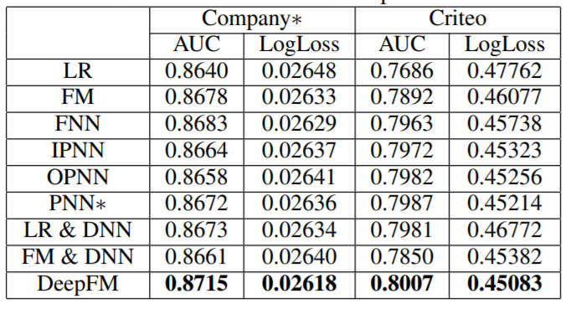
[2017-IJCAI] DeepFM A: Factorization-Machine based Neural Network for CTR Prediction
Characteristics:
DeepFM emphasizes both low-order interactions and high-order interactions unlike other FMs with DNNs paying more attention to high-order interactions

Slide 16
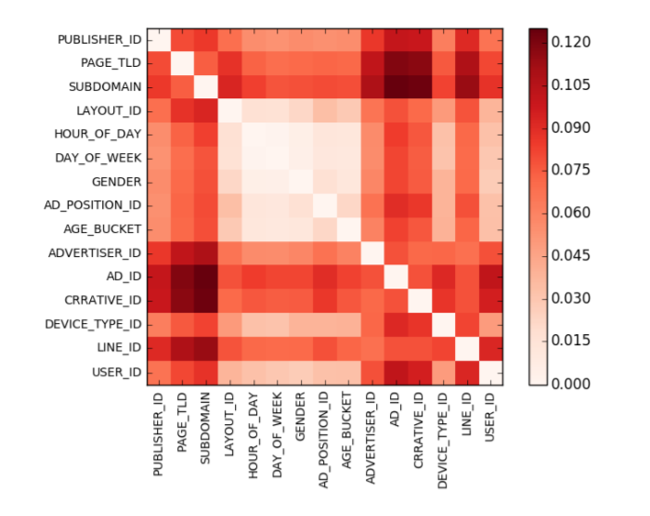


Feature and Interaction Selection
FM can be hindered by its fairly modelling all features and interactions, for it is easy to know that useless information may introduce noises and affect the results.
Overview: Weighting ways for selection; Filtering ways for selection
Weighting ways for selection
To discriminate the importance of different features or interactions, the most straightforward way is leading in weight.
Field-Weighted FM
[Pan et al.,2017]
different importance of interactions from different fields
Further, [Hong et al. ,2019]changed the weight scalar into vector

Slide 17
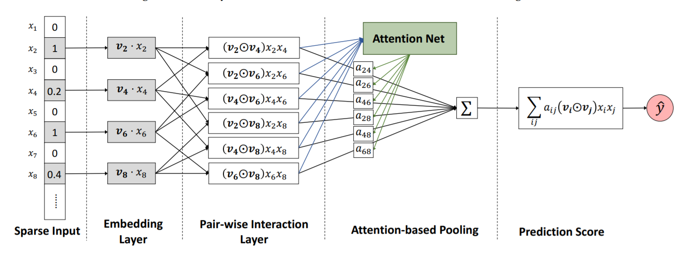
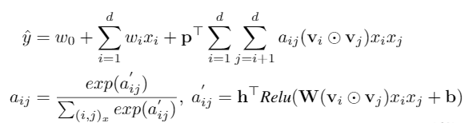

Feature and Interaction Selection
Attention FM
AFM uses Attention Net to learns the weight for every interactions.
Filtering ways for selection
Another method is filtering, which means only uses useful information and abandons unless information fully.
Gradient Boosting FM
propose a greedy interaction feature selection algorithm based on gradient boosting.
borrow the idea of boosting methods to select one interaction feature at each step and additively optimize the target function.

Slide 18


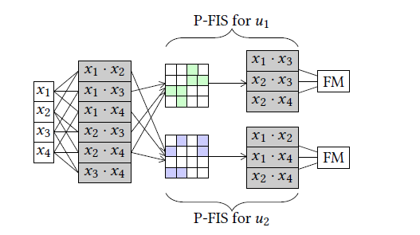

Feature and Interaction Selection
Sparse FM
aimed at select significant features by removing the effect of useless features.
Bayesian Personalized Feature Interaction Selection (SIGIR ’19)
FM unreasonable: all users share the same feature interactions
Every user has personalized features and interactions importance like the Input-aware (IJCAI ’19) concept.

Slide 19


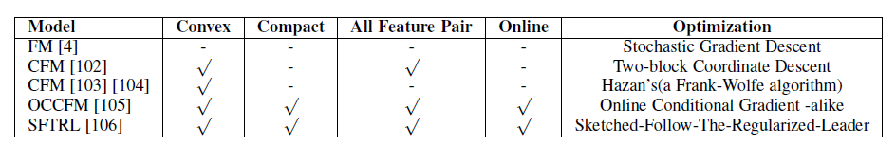
Whole Model Improvement
Overview: Convex FM; General FM; Locally Linear FM;
Convex FM
Standard factorization machines involve a non-convex optimization problem, so it may only obtain a bad local solution and makes prediction results heavily dependent on initialization.
Multi-block Convex:
treat the feature weight vector and the feature interaction matrix as separated parameters, w; W, respectively.
Global Convex

Slide 20


Whole Model Improvement
General FM
Although FMs have been widely used, their theoretical characteristics are rarely studied.
Locally Linear FM
FMs fails to capture underlying structure of complex data and therefore can not perform well in
non-linear problems. They adopt locally linear coding to approximate a non-linear function:

Slide 21
Outline:
Basic Factorization Machine
Improvement of Factorization Machine
Application in Recommendation System

Slide 22



Application in recommender system
Rating Prediction
CTR Prediction
Multi-class/Multi-task Recommendation
existing FMs have been limited to single-output models (i.e., learning scalar-valued functions).
Defined the learning problem of multioutput FM as the problem of learning a 3-way tensor whose slices share a common basis.

Slide 23



Application in recommender system
Ranking Recommendation
Ranking FMs have been proposed using pairwise instances from implicit feedback.
Position-Independent
Bayesian Personalized Ranking (BPR) makes an assumption that users are more interested in selected items than others.
The major differences of these models are loss function
cross entropy
empirical hinge loss
log likelihood

Slide 24
Application in recommender system
Position-Dependent
Lambda-based method is helpful for above question which leads in listwise information when dealing with pairwise instances.
Lambda-FM

Slide 25

Application in recommender system
Sequential Recommendation
FM is a static model which ignores sequential dependencies in user item interactions.
Pasricha et al. proposed TransFM which combines translation and metric-based approaches with FM for Sequential Recommendation.
learns the embedding and translation vectors for each feature
(the user u, the previous item i, the next item j and additional content features)

Slide 26
Application in recommender system
Cross-Domain Recommendation
In the real world, two different datasets would contain some of the coupled field, e.q. two movie rating websites (e.g. MovieLens and Netflix) have different registered users, but many movies are the same.
model simultaneously studies:
latent vector sharing part of coupled fields
latent vector domainspecific differences part of coupled fields
latent vector of noncoupled fields

Slide 27
Thanks for Listening!
Factorization Machine Techniques for Recommender Systems: A Survey

